Slide 1

CMR COLLEGE OF ENGINEERING & TECHNOLOGY
(UGC Autonomous)
(NAAC Accredited with ‘A+’ Grade & NBA Accredited) (Approved by AICTE, Permanently Affiliated to JNTU Hyderabad)
KANDLAKOYA, MEDCHAL ROAD, HYDERABAD - 501401
Department of Electronics And Communication Engineering
A Mini Project/Internship Report on
SMART FENCING TO PROTECT THE CROPS FROM WILD ANIMALS
BATCH NO: D-10
TEAM DETAILS: MAMIDIPELLY DIVYA
KAMALAPALLI RUSHIKESH
MADDURU RUDRA SIMHA
Under the esteemed guidance of:
DR.P.RAVI KIRAN
Associate professor
(22H51A04HO) (22H51A04G1) (22H51A04G8)
1

Slide 2
CONTENT
SMART FENCING TO PROTECT THE CROPS WILD ANIMALS
AIM
OBJECTIVES
PROPOSED METHOD
BLOCK DIAGRAM
RESULT
DISADVANTAGES & ADVANTAGES
COMPARISION TABLE
CONCLUSION
REFERENCES
BATCH NO: D-10

Slide 3

SMART FENCING TO PROTECT THE CROPS WILD ANIMALS
AIM
To design and implement a smart fencing system using advanced sensor technologies and automated deterrents to effectively protect agricultural crops from intrusion and damage caused by wild animals, thereby reducing crop losses and enhancing food security for farmers.
BATCH NO: D-10

Slide 4


OBJECTIVES
SMART FENCING TO PROTECT THE CROPS WILD ANIMALS
To develop a smart fencing system that can detect the presence of wild animals near agricultural fields using appropriate sensors.
To automatically activate deterrent mechanisms (such as lights, alarms, or water sprinklers) to scare away animals without causing harm.
To ensure the system is cost-effective, easy to install, and suitable for small and medium-scale farmers.
To reduce crop damage and economic losses caused by wild animals, thereby increasing agricultural productivity.
BATCH NO: D-10

Slide 5
PROPOSED METHOD
SMART FENCING TO PROTECT THE CROPS WILD ANIMALS
Install Sensors: Place motion or infrared sensors around the field to detect animal movement.
Use Microcontroller: Connect sensors to a microcontroller (e.g., Arduino) for data processing.
Activate Deterrents: Trigger alarms, lights, or sprinklers automatically to scare animals away.
Send Alerts: Use GSM or IoT modules to send real-time alerts to the farmer’s phone.
Power Supply: Use solar panels for continuous, eco-friendly power.
Testing: Test the system in the field and optimize for performance.
Maintenance: Provide simple maintenance instructions and basic training for farmers.
BATCH NO: D-10

Slide 6
PROPOSED METHOD
SMART FENCING TO PROTECT THE CROPS WILD ANIMALS
The proposed system is an Arduino-based smart fencing solution designed to protect crops from wild animals.
It uses IR sensors to detect animal movement near the field boundary.
When an intrusion is detected, the system Activates a buzzer to scare away the animal, Turns on a DC motor via a motor driver to simulate mechanical deterrents, Displays alerts on an LCD screen, and Can send alerts to farmers (if GSM/IoT modules are added).
The system runs on a regulated power supply and can be adapted for solar energy in remote areas.
BATCH NO: D-10

Slide 7
BLOCK DIAGRAM
SMART FENCING TO PROTECT THE CROPS WILD ANIMALS
Power supply
IR SENSOR
LCD
Buzzer
Arduino
Motor Driver
DC Motor
IR SENSOR
BATCH NO: D-10

Slide 8
RESULT
SMART FENCING TO PROTECT THE CROPS WILD ANIMALS
Detection Accuracy: ~85–90% (IR detects animal movement)
Response Time: <1 second (fast alert)
Alert System: Buzzer + LCD shows “Intruder Detected”
Deterrent Action: DC motor activates moving object or sound
Power Use: Low (runs on battery or adapter)
Coverage: Small area (\~10–20 cm per sensor)
Limitations: Not suitable for large fields or advanced detection
BATCH NO: D-10

Slide 9
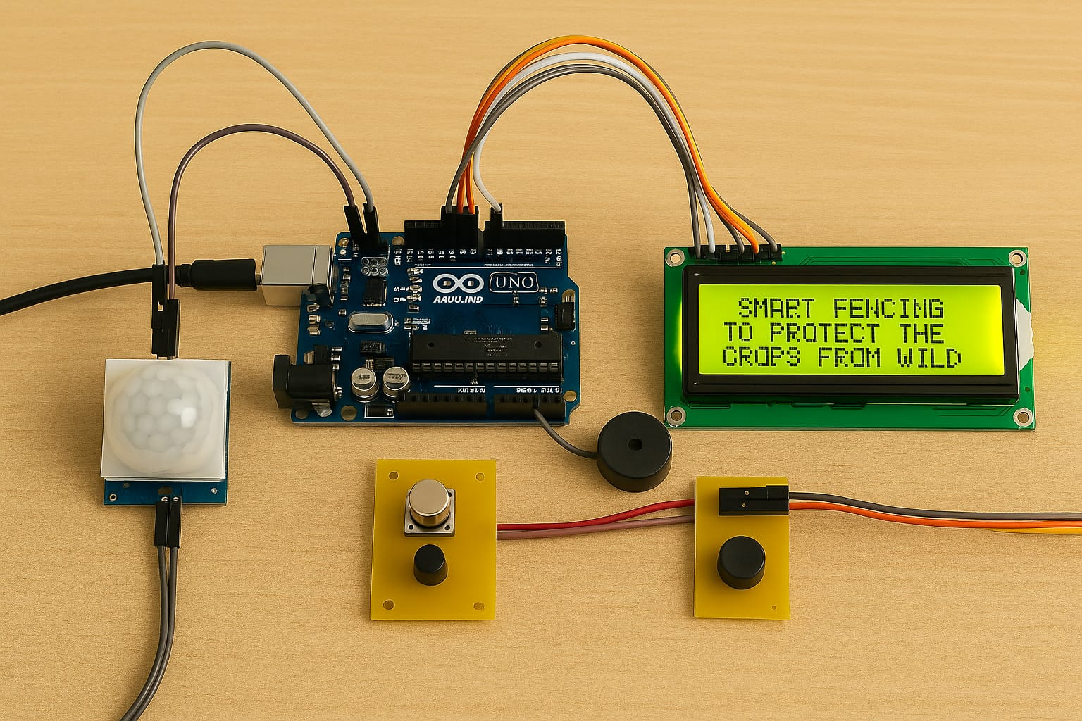
RESULT
SMART FENCING TO PROTECT THE CROPS WILD ANIMALS
Prototype design
BATCH NO: D-10

Slide 10

ADVANTAGES
SMART FENCING TO PROTECT THE CROPS WILD ANIMALS
🔹 Protects Crops
• Prevents crop damage by detecting and deterring wild animals in real time.
🔹Automatic Operation
• Works without human intervention using sensors and programmed responses.
🔹Cost-Effective
• Uses affordable components making it suitable for small farmers.
🔹Energy Efficient
• Can operate on low power and be adapted to run on solar energy.
🔹Quick Response Time
• Activates deterrents (buzzer, motor) within seconds of detection.
🔹User-Friendly
• Displays status on an LCD for easy monitoring and use..
10
BATCH NO: D-10

Slide 11

DISADVANTAGES
SMART FENCING TO PROTECT THE CROPS WILD ANIMALS
🔸 Limited Detection Range
• IR sensors may have a restricted range and might not detect animals at a distance.
🔸 False Alarms
• Movement of other objects like wind-blown plants or small animals could trigger false alerts.
🔸 Power Dependency
• System requires a stable power source
🔸 Maintenance Required
• Sensors and mechanical parts need regular maintenance to ensure proper functioning.
🔸 Initial Setup Cost
• Though affordable, the initial cost may still be a barrier for some small-scale farmers.
BATCH NO: D-10
11

Slide 12
COMPARISON TABLE
Feature | Traditional Fencing | Arduino smart fence
Detection | No detection capability | IR Sensor based
Alerts | No Alerts | Buzzer+LCD
Deterrent | Manual | Real time(LCD)
Power | Not needed | Required(Battery)
Automation | No | Yes
Maintenance | Low | Moderate
Best for | Large open fields | Small Farms
BATCH NO: D-10
12

Slide 13
CONCLUSION
SMART FENCING TO PROTECT THE CROPS WILD ANIMALS
📌 The system successfully detects animal movement using IR sensors.
📌 It provides real-time alerts through a buzzer and LCD display.
📌 The DC motor activates a deterrent to scare animals away.
📌 Improves crop safety and reduces manual effort.
📌 Offers automation and monitoring, unlike traditional fencing
BATCH NO: D-10

Slide 14
REFERENCES
SMART FENCING TO PROTECT THE CROPS WILD ANIMALS
[1] Rajesh Mallela, Pidugu Nagendra, Kadiyala Ramana, Internet of Things –Future Internet Technologies, Elements and Applications, International Journal of Research and Analytical Reviews, Volume.5, Issue 4, Page No pp.960-967, October 2018
[2] Bindu D et al, International Journal of Engineering, Basic sciences, Management & Social studies, Volume 1, Issue 1, May 2017.
[3] Krishnamurthy b et al, International Journal of Latest Engineering Research and Applications (IJLERA) ISSN: 2455-7137, Volume – 02, Issue – 05, May – 2017, PP – 128-135.
[4] Kshama S.Bhise, International Journal of Scientific & Engineering Research, Volume 7, Issue 2, February-2016 ISSN 2229-5518.
[5] V. Deshpande, International Journal of Science and Research (IJSR) ISSN (Online): 2319-7064 Index Copernicus Value (2013): 6.14 | Impact Factor (2014): 5.611.
BATCH NO: D-10

Slide 15
SMART FENCING TO PROTECT THE CROPS WILD ANIMALS
THANK YOU
BATCH NO: D-10

